Slide 1


ECEN 404 Final Presentation Team 70: VFD Motor Controller
Mackenzie Miller
Andrew Nguyen
Aidan Rader
Ryan Regan TA: Ali Alenezi Sponsor: John Lusher
Notes:
Mackenzie
30 seconds
Guidance on preparing final presentation:
-This is not a project update – DO NOT use old templates, do not do the accomplishments/on-going table thing, do not show execution/validation plans.
-Each team will have 10 minutes to do the final presentation. You will be stopped if you go over so practice to make sure you stay within 10 minutes
-You will cover design and validation accomplishments for your project. Each team member should speak on end-to-end use scenarios that relied on their engineering contributions – you will be assessed on the difficulty/complexity of your design work, what you delivered, what engineering skills & reasoning you applied (3pts); progress and completeness of design, test, and validation (2pts); and quality of slides and presentation skill (2pts).
-Results – tables, figures, pictures that reinforce your design/test/validation are encouraged. BUT do not use your very short time to show videos of flights, bench test procedures, walk through code, or talk thru details of a figure. Save Demo content for the demo!
-This presentation will be the culmination of your improved presentation skills. Think of this as a formal presentation to a VP, a VC, or a Client. Avoid informal and slang language; avoid informal, familiar delivery; avoid jokes or humor. Be clear, concise, and don’t try to bluff through what is not complete or is problematic.
-Dress should be business casual or business formal.
-Be on time for presentations – with a flash drive. We do not have time for 2 minute transfers between presentations or arrive before class and copy your presentation to the PC desktop (we will delete these at the end of the day)
-Q&A will be limited to 1 minute – and will just be to clarify things from the presentation.
Feedback will be given on canvas as part of grading.

Slide 2
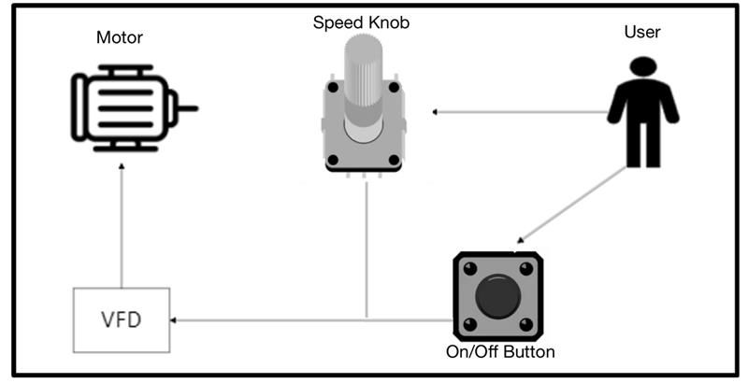
Project Overview
Problem: Traditional motor control systems cannot adjust to varying load demands, resulting in poor energy efficiency, excessive heat generation, and premature component failure
Solution: Develop a Variable Frequency Drive (VFD) motor control system to adjust frequency and voltage to load demands
Notes:
Mackenzie
30 seconds
Summary of your problem being solved and high level summary of your solution.

Slide 3
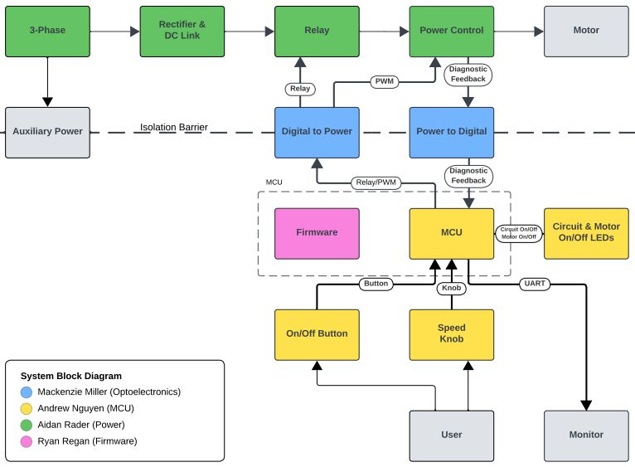
Project Overview – Block Diagram
Notes:
Aidan
30 seconds
Diagram showing subsystems – with labels showing subsystem owners

Slide 4
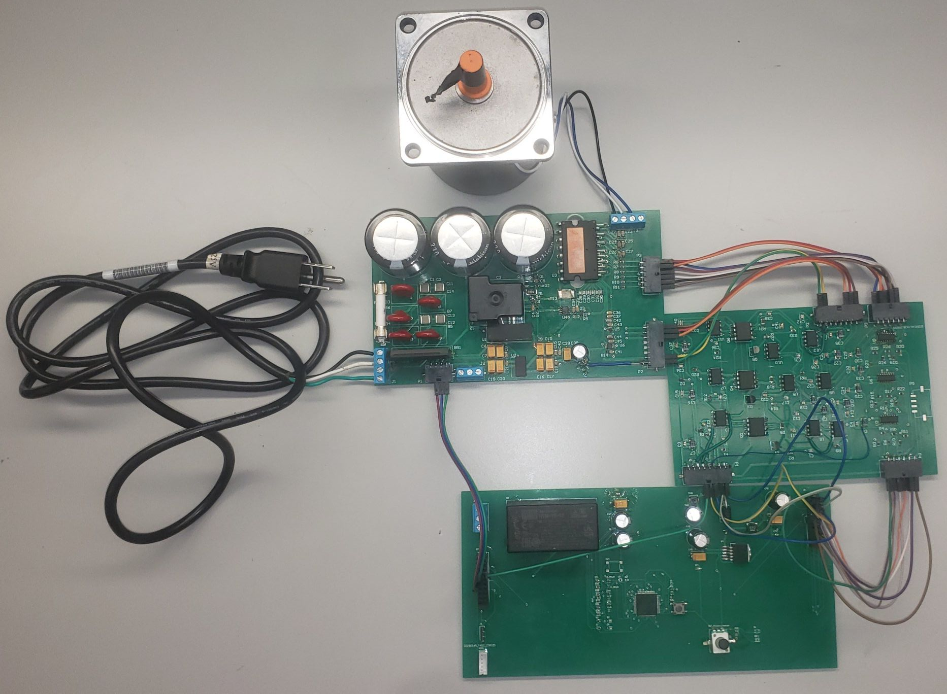
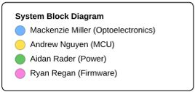
Integrated System Diagram
Notes:
Aidan
60 seconds
-Picture (or collection of pictures) or drawing of system
-Major components labeled
-Show how user connects (ui screens, pictures, etc)
-Label major connections/interfaces

Slide 5
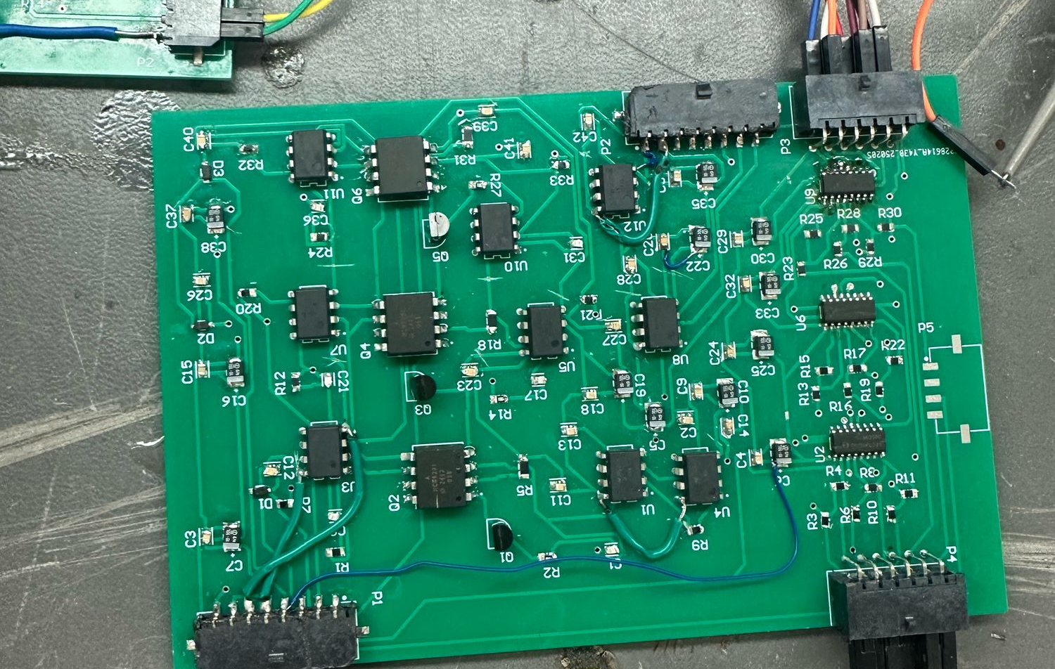
Engineering Design Accomplishments
Mackenzie Miller
Completed digital isolation PCB design
Tested and validated digital isolation circuit – 3.3V in, 5V out
6 PWM signals – 3 phases H and L
Tested and validated relay signal isolation
PWM output responds to potentiometer
Completed analog isolation PCB design
Voltage, temperature, and current
Tested analog isolation 1:1 ratio
Have yet to fully test feedback
Notes:
Mackenzie
60-90 seconds
-Each team member should in 2 – 3 slides show what they designed, tested, and validated. -List challenges / solutions where appropriate. -Present data (table?) with requirement description (eg rover drill placement accuracy); what spec(s) for that requirement (eg mean error in positioning), measured range of results (min 1.2cm, mean 4 cm, max 11cm); -Accomplishments should be backed up with quantitative test results and requirements validation

Slide 6
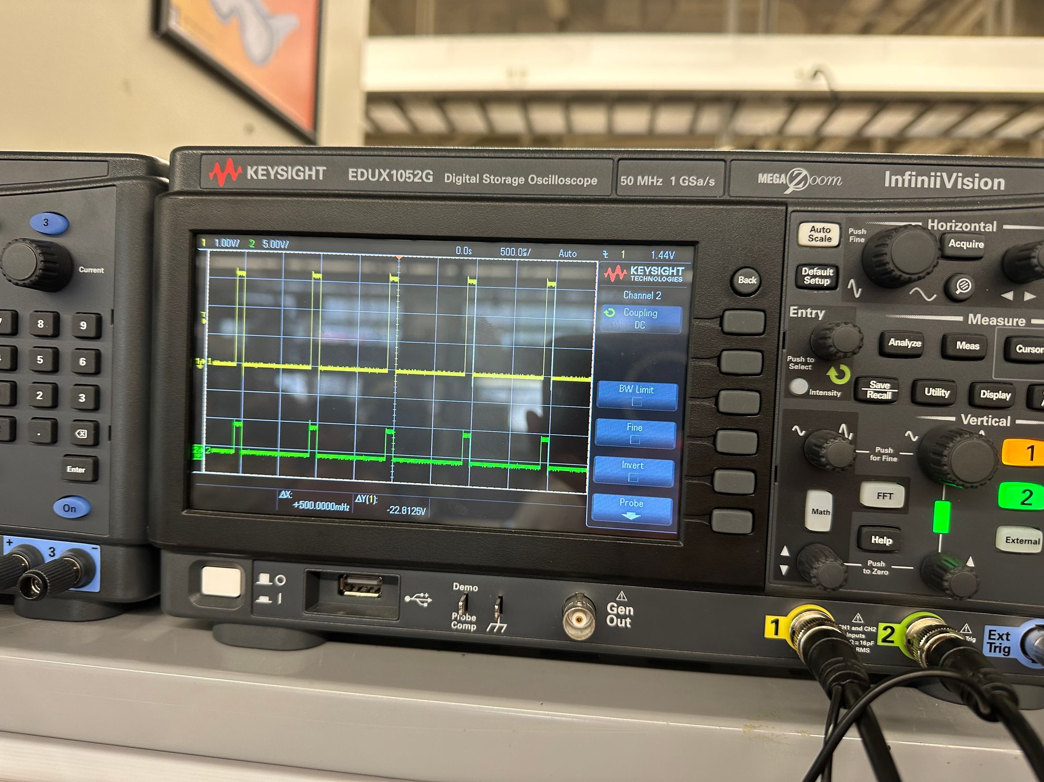
Engineering Design Accomplishments
Mackenzie Miller
PWM input | PWM output
1H – 3.3V | 5V
1L – 3.3V | 5V
2H – 3.3V | 5V
2L – 3.3V | 5V
3H– 3.3V | 5V
3L – 3.3V | 5V

Slide 7
Challenges/Solutions Mackenzie Miller
Challenges:
Lack of knowledge/experience
Altium
PCB design
Proper testing
Trace Errors
Vcc and GND switched on opamps – resulted in voltage drop
3.3V not connected to digital isolators
Getting all components to work at the same time
Solutions:
Trial and error, asking questions, learned as time went on
Rerouted and ordered new board/cut traces and blue
Fixed some unrouted capacitors
Rearranged connectors for convenience
Manually switched Vcc and GND with blue wire
Replaced parts as needed, once trace errors were fixed, this problem lessened

Slide 8
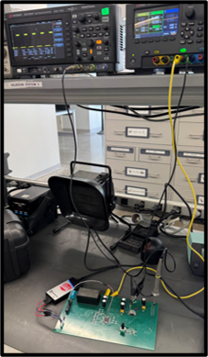
Engineering Design Accomplishments
Andrew Nguyen
Designed and tested 3.3V buck converter
Designed and tested AC/DC converter
Verified that the MCU received 3.3V to all the necessary pins
Successfully flashed firmware onto PCB using Pickit5
MCU sends relay signal
Button turns motor on and off
MCU sends correct PWM signals
Potentiometer functions properly
PWM output after flashing code
Notes:
Drew
60-90 seconds
-Each team member should in 2 – 3 slides show what they designed, tested, and validated. -List challenges / solutions where appropriate. -Present data (table?) with requirement description (eg rover drill placement accuracy); what spec(s) for that requirement (eg mean error in positioning), measured range of results (min 1.2cm, mean 4 cm, max 11cm); -Accomplishments should be backed up with quantitative test results and requirements validation

Slide 9
Engineering Design Accomplishments
Andrew Nguyen
Load [mA] | V_{out} [V]
0 | 3.2993
30 | 3.2952
50 | 3.2824
72 | 3.2812
95 | 3.2601
122 | 3.2512
153 | 3.2243
V_{in} [V] | V_{out} [V]
16.0 | 3.3003
15.5 | 3.2997
15.0 | 3.2997
14.5 | 3.2995
Buck Converter Line Regulation Test
Buck Converter Load Regulation Test
V_{in} [VAC] | V_{out} [VDC]
118 (wall) | 15
AC/DC Converter Test
Notes:
Drew
60-90 seconds
-Each team member should in 2 – 3 slides show what they designed, tested, and validated. -List challenges / solutions where appropriate. -Present data (table?) with requirement description (eg rover drill placement accuracy); what spec(s) for that requirement (eg mean error in positioning), measured range of results (min 1.2cm, mean 4 cm, max 11cm); -Accomplishments should be backed up with quantitative test results and requirements validation

Slide 10
Challenges/Solutions Andrew Nguyen
Challenges:
Lack of PCB design knowledge
Flashing the firmware onto the MCU
Making sure the MCU received 3.3V to all the proper pins
Solutions:
Researched, worked with team and others, lots of trial and error, asked questions
Ensured the AVDD pin received 3.3V by rerouting board (originally blue wired) and switched to a new Pickit5 since the Pickit4 was faulty
Rerouted PCB, adjusted trace widths accordingly for ground and the AC/DC converter and buck converter outputs, changed resistors and capacitors

Slide 11
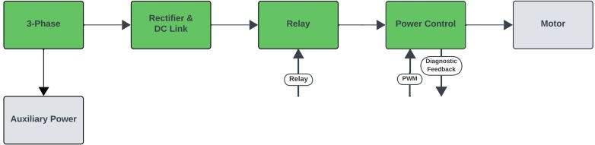
Engineering Design Accomplishments
Aidan Rader
15 V_{DC} to Isolated 15 V_{DC} Converter
3.3 V_{DC} to Isolated 5 V_{DC} Converter
V_{in} [V] | V_{in,pp} [mV] | V_{out} [V] | V_{out,pp} [mV]
9.1 | 200 | 15.1 | 400
15.1 | 500 | 15.0 | 400
20.9 | 500 | 14.9 | 400
27.0 | 500 | 15.3 | 500
33.0 | 578 | 14.9 | 264
35.8 | 503 | 14.9 | 264
V_{in} [V] | V_{in,pp} [mV] | V_{out} [V] | V_{out,pp} [mV]
2.8 | 500 | 4.9 | 500
3.2 | 500 | 4.8 | 500
3.3 | 500 | 5.3 | 500
3.6 | 500 | 5.7 | 500
Notes:
Aidan
60-90 seconds
-Each team member should in 2 – 3 slides show what they designed, tested, and validated. -List challenges / solutions where appropriate. -Present data (table?) with requirement description (eg rover drill placement accuracy); what spec(s) for that requirement (eg mean error in positioning), measured range of results (min 1.2cm, mean 4 cm, max 11cm); -Accomplishments should be backed up with quantitative test results and requirements validation

Slide 12
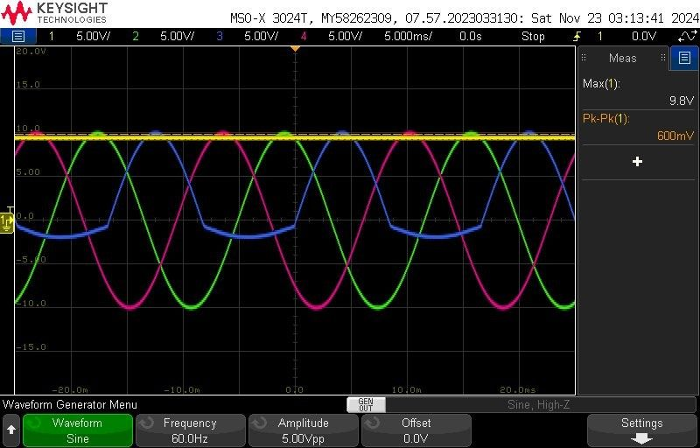
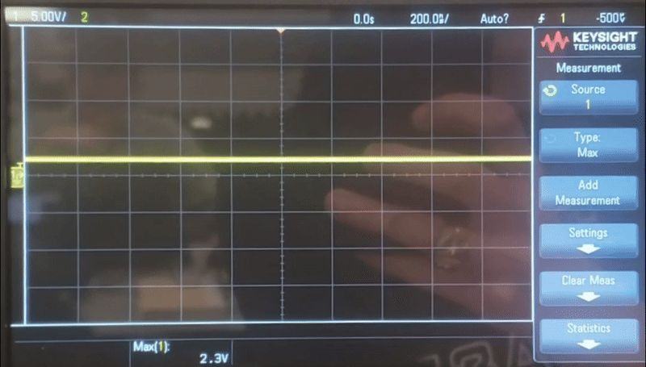
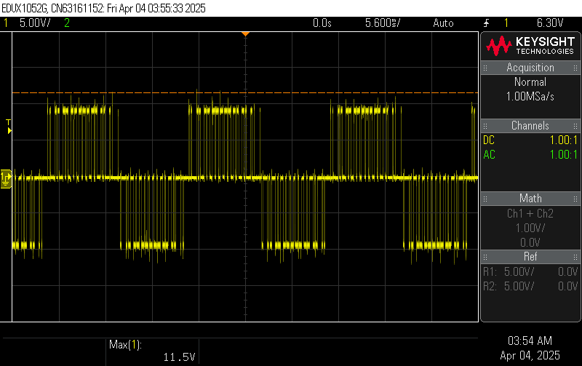
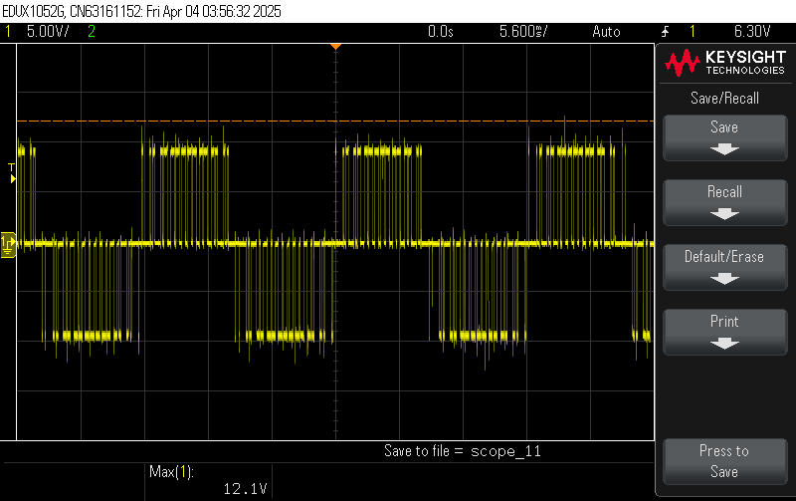
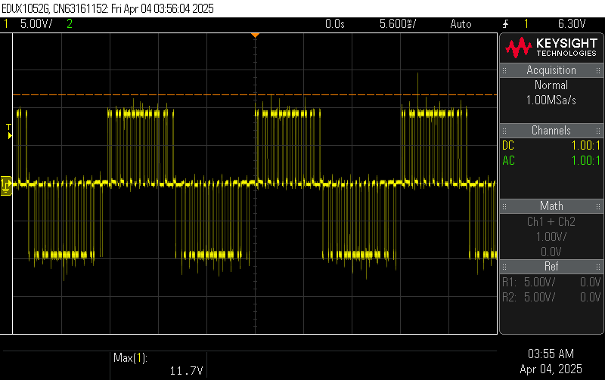
Engineering Design Accomplishments
Aidan Rader
Diagnostic feedback: voltage, current, temperature, in progress
Rectifier & DC Link
Relay
Power Control
Notes:
Aidan
60-90 seconds
-Each team member should in 2 – 3 slides show what they designed, tested, and validated. -List challenges / solutions where appropriate. -Present data (table?) with requirement description (eg rover drill placement accuracy); what spec(s) for that requirement (eg mean error in positioning), measured range of results (min 1.2cm, mean 4 cm, max 11cm); -Accomplishments should be backed up with quantitative test results and requirements validation

Slide 13
Challenges/Solutions Aidan Rader
Challenges:
Lack of knowledge over power electronics
Lack of knowledge on electronic load testing
Missing and incorrectly routed traces on original board
High voltage testing fried rectifier and traces
Solutions:
Conducted research and registered in ECEN 438 (Power Electronics)
Conducting research and postponing test
Designed new board and blue-wired remaining trace errors
Replaced rectifier and blue-wired traces, worked on high voltage testing with Professor, and pushed high voltage testing to the end of the project

Slide 14
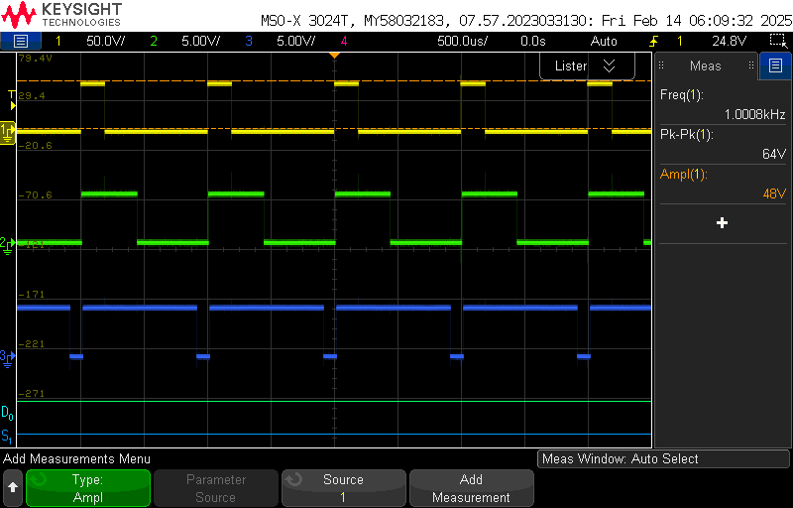
Engineering Design Accomplishments
Ryan Regan
Wrote a C language program in MPLAB X IDE to instruct a dsPIC33CK256MP508 microcontroller as part of a Variable Frequency Drive
Three phase PWM signals
Oscillating duty cycles
Sine wave table
Potentiometer
Timing
Relay start/stop button
(In progress) Diagnostic feedback signals
Learned how to solder and desolder to increase team efficiency
Notes:
Mackenzie
60-90 seconds
-Each team member should in 2 – 3 slides show what they designed, tested, and validated. -List challenges / solutions where appropriate. -Present data (table?) with requirement description (eg rover drill placement accuracy); what spec(s) for that requirement (eg mean error in positioning), measured range of results (min 1.2cm, mean 4 cm, max 11cm); -Accomplishments should be backed up with quantitative test results and requirements validation

Slide 15
Challenges/Solutions Ryan Regan
Challenges:
Lack of experience working with MPLAB X IDE and C code
Several varying issues with code
Frequency range too low
Issues with integrations
Flashing firmware onto Microcontroller PCB
Sending PWM signals through Optoelectronics PCB
Solutions:
Read through user's manual for development board and microcontroller, and watched instructional videos on people programming similar controllers with MPLAB X IDE
Debugged and learned more about MPLAB's Code Configurator
Put PWM function under a timer interrupt so the print statements would not affect frequency
Helped teammates with finding problematic components between integrations
Learned how to solder and desolder to increase efficiency

Slide 16
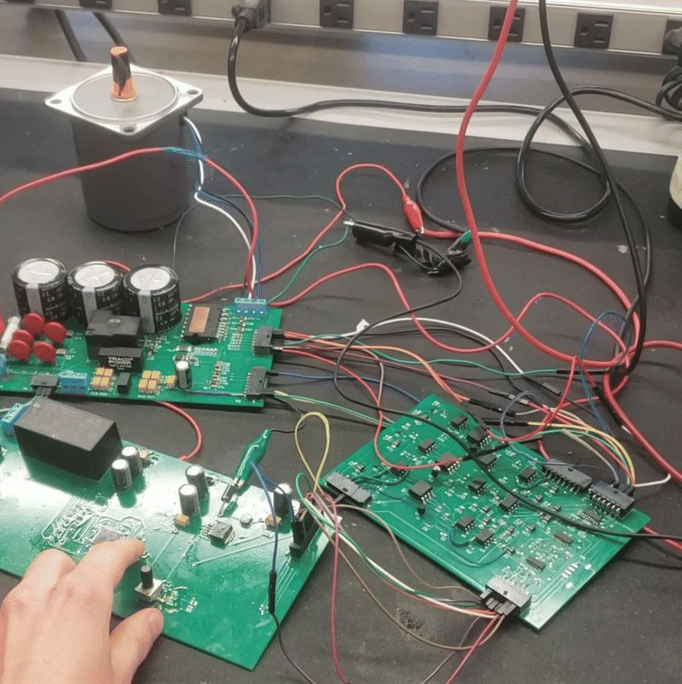
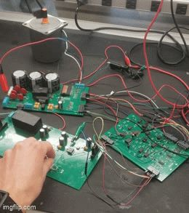
Integrated System Results
Motor On/Off LED
Circuit On/Off LED
Diagnostic Feedback
Speed Knob
On/Off Button
PWM Signals
Notes:
120 seconds
-This section shows end-to-end system operation -Show and provide details on a few important end-to-end use scenarios that you developed and validated. Giving results (be quantitative here – results for key performance indicators ... time to complete task, overall accuracy of task, success/fail measures)

Slide 17
Conclusions
System Design Changes:
Removed tachometer
Added computer/monitor for UART console in diagnostic feedback
Current Status:
Integration and low voltage testing complete except for diagnostic feedback:
diagnostic feedback to be completed by 4/22
Validation ongoing:
to be completed by 4/24
High voltage testing incomplete:
to be completed on 4/24
Notes:
60 sec
-List issues encountered that required changes from system described in Conops, FSR/ICD and resulting system design changes -Current status (eg. integration/test/validation complete; Integration complete, but BT comm not fully validated; Repeating testing for replacement PCB, integration/validation to be completed in 1 week)

Slide 18
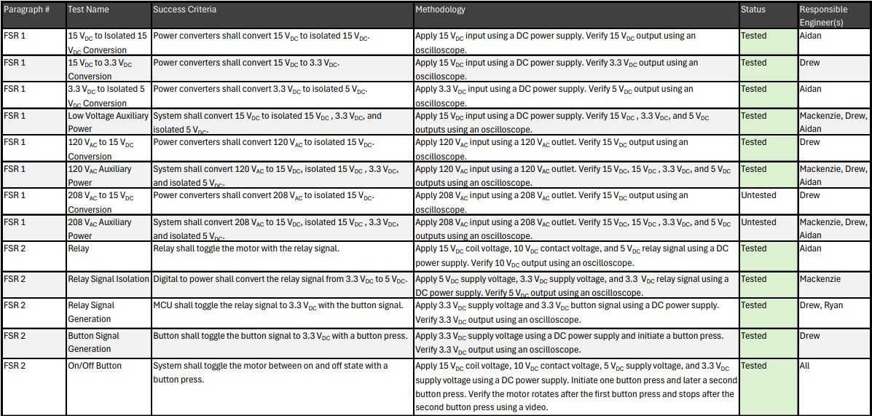
Conclusions
Notes:
60 sec
-List issues encountered that required changes from system described in Conops, FSR/ICD and resulting system design changes -Current status (eg. integration/test/validation complete; Integration complete, but BT comm not fully validated; Repeating testing for replacement PCB, integration/validation to be completed in 1 week)

Slide 19
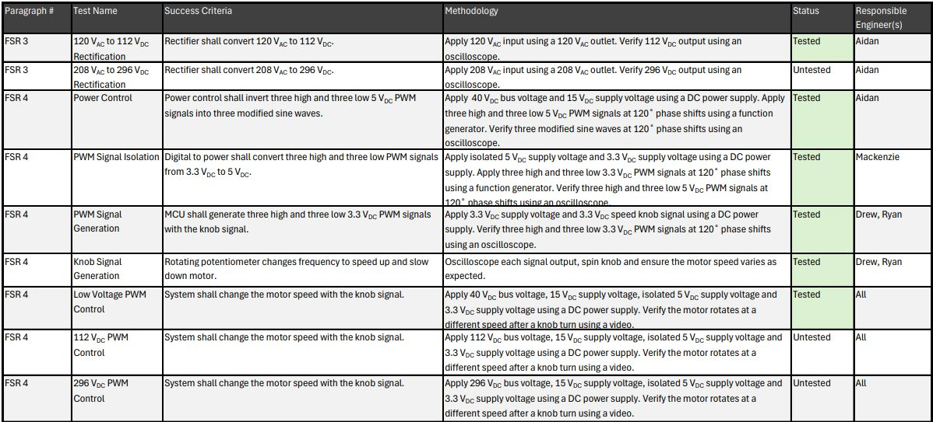
Conclusions
Notes:
60 sec
-List issues encountered that required changes from system described in Conops, FSR/ICD and resulting system design changes -Current status (eg. integration/test/validation complete; Integration complete, but BT comm not fully validated; Repeating testing for replacement PCB, integration/validation to be completed in 1 week)

Slide 20
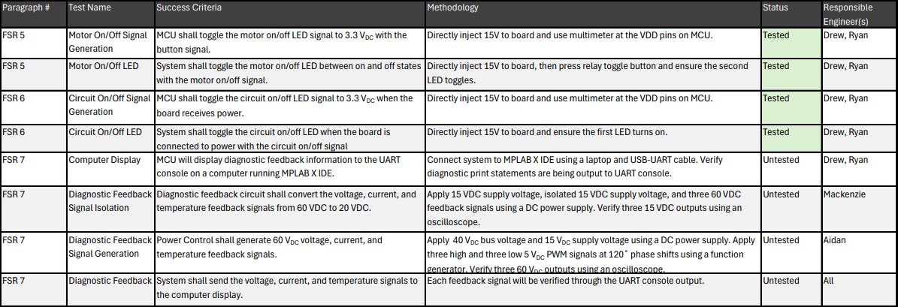
Conclusions
Notes:
60 sec
-List issues encountered that required changes from system described in Conops, FSR/ICD and resulting system design changes -Current status (eg. integration/test/validation complete; Integration complete, but BT comm not fully validated; Repeating testing for replacement PCB, integration/validation to be completed in 1 week)

Slide 21
Thank you

